Slide 1


SAGI RAMA KRISHNAM RAJU ENGINEERING COLLEGE
ELECTRONICS & COMMUNICATION ENGINEERING DEPARTMENT
Enhanced Identification of missing persons using Machine Learning Techniques
Presented By, Batch 12 - ECE B
G. Siri Chandana (20B91A0488)
G. L. Narsimham (20B91A0486)
M. Nameela (20B91A04E1)
G. Sasi Tharun (20B91A0489)
Under the guidance of
Mrs. D.V.N.Bharathi, Mtech
Assistant Professor ECE Department

Slide 2


Abstract
The issue of missing persons is a significant concern globally, with thousands of individuals disappearing every year, leaving their families and communities in a state of anguish and uncertainty.
To address this pressing challenge, this project introduces an innovative approach for Missing Persons Identification by storing personal details, physical characteristics, last seen locations and etc for quick identification

Slide 3
Introduction
The structured database ensures efficient data organization, allowing quick access and retrieval of information, thereby expediting the identification process.
To enhance the effectiveness of the system, an Email Alert System is incorporated, which automates the dissemination of missing person alerts to a wide network of stakeholders.
When a new missing person report is added to the database, the system generates and sends email alerts to law enforcement agencies, non-profit organizations, shelters, and other relevant entities.

Slide 4
Technologies to be involved
Machine learning
open cv
Facial Recognition Modules
Python
E-Mail alerting system

Slide 5
Existing systems in real life and challenges
Paper based records and social media
Limited information share
Manual alerts
Inefficiency and delay
Lack of technology integration

Slide 6
Problem Statement
The Challenge:
Inefficient Methods: Current missing person searches rely heavily on manual efforts and outdated technologies, leading to delays and missed opportunities.
Information Gaps: Disparate databases and siloed information hinder swift, coordinated searches.
The Solution:
Centralized Database: An SQL database consolidates and organizes missing person information, enabling efficient searching and analysis.
AI-powered Matching: Facial recognition algorithms accurately match reported sightings with missing person records, reducing human error and increasing speed.
Real-time Alerts: An automated email system immediately notifies relevant parties (law enforcement, support groups) of potential matches, facilitating rapid response.

Slide 7


Uniqueness of the proposed system
Facial Matching
Image sharing
Secure
When a missing person is reported, their photograph is uploaded to the system, and facial recognition algorithms are employed to compare it with images stored in the database.
These images may include photographs of found individuals, unidentified individuals in morgues or shelters, or even publicly available images..
Access to the SQL database is carefully controlled, and user authentication is required for any data entry or retrieval actions.

Slide 8
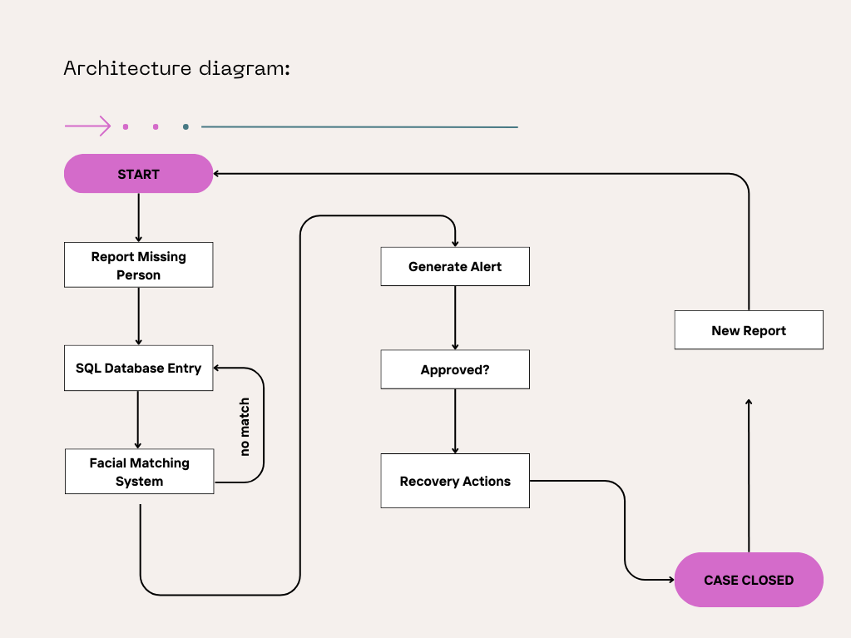
Architecture of proposed system

Slide 9
Requirements for project
Hardware specifications:
Microsoft Server enabled computers, preferably workstations
Higher RAM, of about 4GB or above
Processor of frequency 1.5GHz or above
Software specifications:
Python 3.10.10
VS Code
Various python libraries

Slide 10


Project management plan
Dec – Literature survey and Data acquisition
Jan – Project ideation and Unit testing
Feb – Creation of web interface and Testing Fusion with Email Alerting
Mar – Batch testing and Integration testing
Apr - Deploying project

Slide 11
Progress Descrption
Conducted thorough literature survey for project ideation.
Initiated project development phase by identifying project requirements.
Central to the project is the face_recognition module, serving as the foundation for person identification.
Progressed from static image processing to dynamic video analysis for enhanced functionality.
Developed web interfaces using dynamic HTML and CSS, followed by hosting through Flask in Python.

Slide 12
Advanced project integration by incorporating an email alerting module.
Utilized Google App Passwords for enhanced security and functionality.
Conducted comprehensive batch testing to ensure project robustness and reliability.
Finally deployed the project for global usage with secure authentication

Slide 13

Login page for users

Slide 14
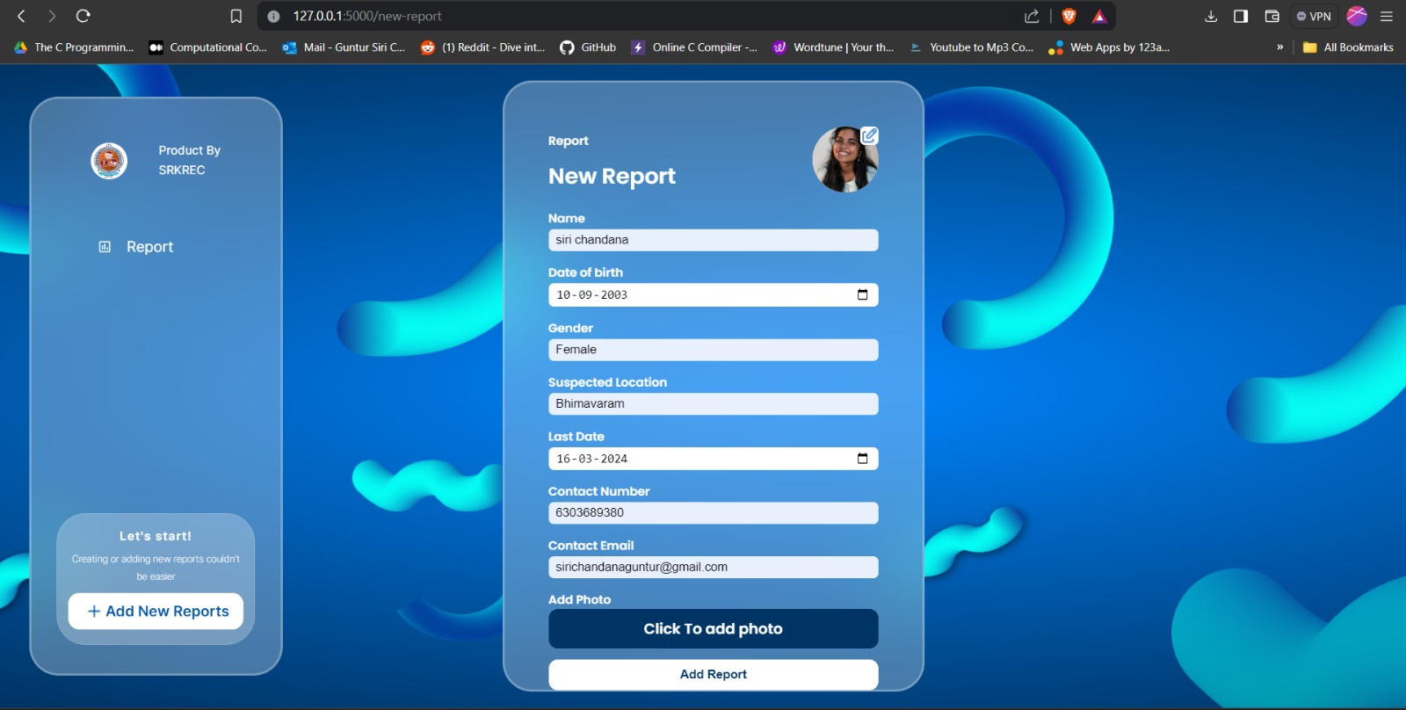
Dashboard for users

Slide 15

Dashboard for admin

Slide 16
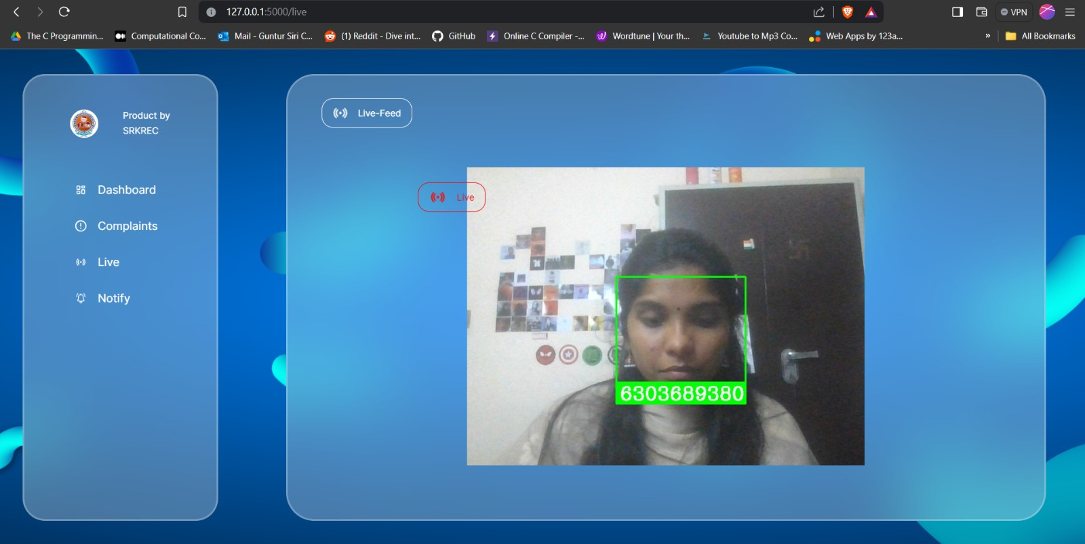
Live detection

Slide 17
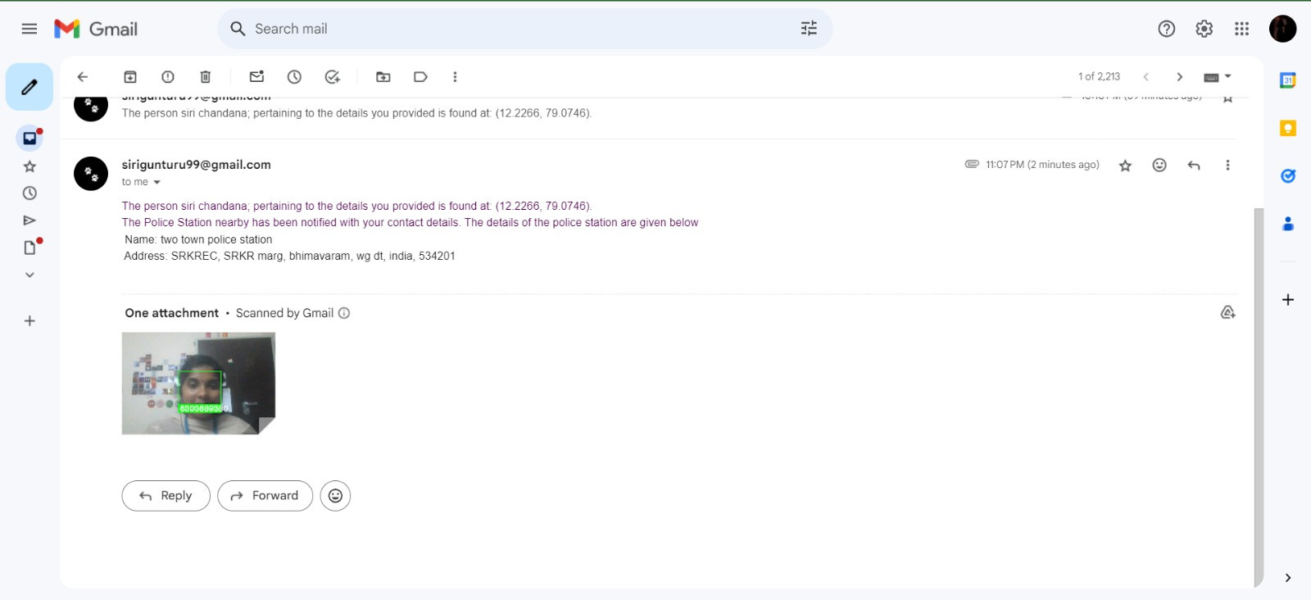
Automated Email Alert with location details

Slide 18
Future Enchancements that can be done
Smarter Matching: Deep learning algorithms can enhance the accuracy of facial recognition, even when appearances have changed due to time or circumstance.
Social Media Sleuthing: Integration with social media platforms can unlock valuable information and leads for missing persons cases.
Wider Netcasting: Expanding email alerts to wider audiences, including law enforcement, NGOs, and the public, can accelerate response and broaden search efforts.
Deeper Data: Adding data points like medical conditions, preferences, and associates to the SQL database can refine searches and expedite reunions.
Constant Evolution: Continuous improvement through advanced facial recognition, social media integration, and data expansion can keep the system at the forefront of missing person identification.

Slide 19
Conclusion
In conclusion, the system designed for Missing Persons Identification leverages latest technologies offering a comprehensive solution for locating missing individuals. It ensures organized and precise storage of critical information related to missing persons, while the email alert system promptly notifies relevant parties upon potential matches, thus increasing the likelihood of successful identification. The incorporation of facial matching techniques adds an extra layer of accuracy by comparing facial features for potential matches.

Slide 20
These studies explored the potential of using SQL databases to store and retrieve information about missing persons. By creating a centralized database, it becomes easier to cross-reference and search for relevant details such as physical descriptions or last known locations
A review of the literature revealed that the combination of SQL databases, email alert systems, and facial matching techniques has proven to be a promising approach. Researchers have developed various prototypes and systems that showcase the potential benefits of such an integrated solution
Inferences from literature survey

Slide 21
One study noted the importance of data quality in the success of the identification process. It emphasized the need for accurate and up-to-date information in the SQL database to ensure reliable search results
Several studies also touched upon the challenges associated with integrating multiple systems, such as SQL databases and email alert systems.
These challenges include data synchronization, system compatibility, and scalability.
Which we aim to eradicate in the proposed system.

Slide 22
References
A. Ponmalar, B. Sandhiya, M. Bhuvaneswari, M. Gayathri, G. Bhavana and S. Aarthi, "Finding Missing Person Using Artificial Intelligence," 2022 International Conference on Computer, Power and Communications (ICCPC), Chennai, India, 2022, pp. 562-565, doi: 10.1109/ICCPC55978.2022.10072122.
Mrs. Vishakha Shelke, Mr. Gunjan Mehta, Ms. Prajakta Gomase, Ms. Trisha Bangera, “Searchious: Locating missing people using an optimised face recognition algorithm”, Fifth International conference on computing,2021 ; doi:https://doi.org/10.22214/ijraset.2022.47747
B. Sridhar, P. S. Rao, M. R. Naik, S. Sharma, S. Prasad and V. Vishwanath, "Missing Children Identification using Face Recognition," 2022 International Conference on Advancements in Smart, Secure and Intelligent Computing (ASSIC), Bhubaneswar, India, 2022, pp. 1-5, doi: 10.1109/ASSIC55218.2022.10088405.
Chaukade, Abhinay. (2022). Finding And Matching the Lost Victim Using AI and ML. International Journal for Research in Applied Science and Engineering Technology. 10. 4468-4476. 10.22214/ijraset.2022.45652.
R. Annamalai, S. S and K. G. Sindhu, "Facial Matching and Reconstruction Techniques in Identification of Missing Person Using Deep Learning," 2023 IEEE 4th Annual Flagship India Council International Subsections Conference (INDISCON), Mysore, India, 2023, pp. 1-7, doi: 10.1109/INDISCON58499.2023.10270804.
Misquitta, J., & Asha, S. (2023, January). SQL Injection Detection using Machine Learning and Convolutional Neural Networks. In 2023 5th International Conference on Smart Systems and Inventive Technology (ICSSIT) (pp. 1262-1266). IEEE

Slide 23
B. Vinavatani, M. R. Panna, P. H. Singha and G. J. W. Kathrine, "AI for Detection of Missing Person," 2022 International Conference on Applied Artificial Intelligence and Computing (ICAAIC), Salem, India, 2022, pp. 66-73, doi: 10.1109/ICAAIC53929.2022.9792672.
S. Alagarsamy, K. V. Sudheer Kumar, P. Vamsi, D. Bhargava and B. D. Hemanth, "Identifying the Missing People using Deep Learning Method," 2022 7th International Conference on Communication and Electronics Systems (ICCES), Coimbatore, India, 2022, pp. 1104-1109, doi: 10.1109/ICCES54183.2022.9835836.
V. Shelke, G. Mehta, P. Gomase and T. Bangera, "Searchious: Locating missing people using an optimised face recognition algorithm," 2021 5th International Conference on Computing Methodologies and Communication (ICCMC), Erode, India, 2021, pp. 1550-1555, doi: 10.1109/ICCMC51019.2021.9418450.
Madhumita R. Baviskar, “Face Tracking and Recognition in Videos: HMM Vs KNN”, International Journal of Advance Research in Computer Science and Management Studies (IJARCSMS), 2013.
Bharath Darshan Bala, D S Kavya, Chandana M, Anush E, Vishwanath R Hulipalled, “Efficient Face Recognition System for Identifying Lost People”, International Journal of Engineering and Advanced Technology (IJEAT), 2019.
Huang, Gary B. And Erik G. Learned-Miller. “Labeled Faces in the Wild: Updates and New Reporting Procedures”, Department of Computer Science, University of Massachusetts Amherst, Amherst, MA, USA, Tech Report, 2014, pp 14–003
S. Chandran, Pournami & Balakrishnan, Byju & Rajasekharan, Deepak & N Nishakumari, K & Devanand, P & M Sasi, P. (2018). “Missing Child Identification System Using Deep Learning and Multiclass SVM”. 113-116. 10.1109/RAICS.2018.8635054
Thomas M. Omweri, “Using a Mobile Based Web Service to Search for Missing People – A Case Study of Kenya”, in International Journal of Computer Applications Technology and Research, Vol. 4, Issue 7, 507 - 511, 2015.

Slide 24
Sumeet Pate, “Robust Face Recognition System for E-Crime Alert”, in International Journal for Research in Engineering Application and Management, Issue 1, MAR, 2O16
Peace Muyambo, 2018, An Investigation on the Use of LBPH Algorithm for Face Recognition to Find Missing People in Zimbabwe, INTERNATIONAL JOURNAL OF ENGINEERING RESEARCH & TECHNOLOGY (IJERT) Volume 07, Issue 07 (July 2018)
S. Ayyappan and S. Matilda, “Criminals and missing children identification using face recognition and web scrapping” IEEE ICSCAN 2020.
Sarthak Babbar, Navroz Dewan, Kartik Shangle, Sudhanshu Kulshreshtra, Sanjeev Patel, “Cross Age Face recognition using Deep Residual Networks”.IEEE 2019 Fifth International Conference on Image Information Processing (ICIIP).
Florian Schrof, Dmitry Kalenichenko and James Philbin “FaceNet: A Unified Embedding for Face Recognition and Clustering” arXiv: 1503.03832V3 [cs.CV], 17 June 2015
Sayan Deb Sarkar and Ajitha Shenoy, “Face Recognition using Artificial Neural Network and Feature Extraction”, IEEE 2020 IEEE 7th International Conference on Signal Processing and Integrated Networks.
Ranjan, R., Sankaranarayanan, S., Bansal, A., Bodla, N., Chen, J. C., Patel, V. M., ... & Chellappa, R. (2018). Deep learning for understanding faces: Machines may be just as good, or better, than humans. IEEE Signal Processing Magazine, 35(1), 66-83

Slide 25


